Slide 1
Crop Production Analysis in India By OFFIAH NNEDIMMA VIVIAN

Slide 2
OBJECTIVE
The Goal is to Predict Crop Yields, Identifying Key Indicators and Metrics that impacts Crop production in India.
This analysis covers Crop production India between the year !997 – 2015.
The range of Crops
Area of Production
Seasons
Gross/Total Production and the States and Districts where they were Produced.

Slide 3

Data Overview Datasets Description: The dataset contains 246,091 records and each record represents the production of specific crops over many years and in different regions. The key fields are:- State Name: Crop production states such as Kerala, Sikkim, Etc -District Name: Production districts such as Kozhikode, Mumbai, etc Crop Type: The name of crops produced such as Rice, sugarcane, etc. Crop year: The year(s) of crop production such as 1997, 2004, 2012 etc.-

Slide 4
Seasons: The season(s) of crop production such as Kharif, Rabi, etc. Area: The area of land for crop production. Production: The amount of each crop produced.
Tools:
The Datasets Was Cleaned With Excel And Analyzed And Visualized With Powerbi

Slide 5
Data Cleaning: The dataset was cleaned in Excel and the missing data in the Production column were replaced as “Blanks” to help identify and fill them up with the necessary data / value.
Descriptive Statistics:
Overall Crop Production Summary-
Total Production Area: 2,953,703,409.23 bn-
Gross Production: 141,000,000,000.00 bn

Slide 6
Analysis- Top Producing Districts and their States Kozhikode which is in Kerala State used 3m of the total area and produced about 15bn (10.82%) of the total gross crop production. Malappuram in Kerala State used 3.21m of the total area and produced 14bn (10.28%). Thiruvananthapuram also in Kerala State used the total area of 2.22m to produce about 10bn (7.1%).
Thissur in kerala state used the area of 2.45m to produce about 9.9bn (7.03%).
Kannur also in kerala used 3.01m of the total area to produce about 9.7bn (6.93%) of the gross crop yield.

Slide 7
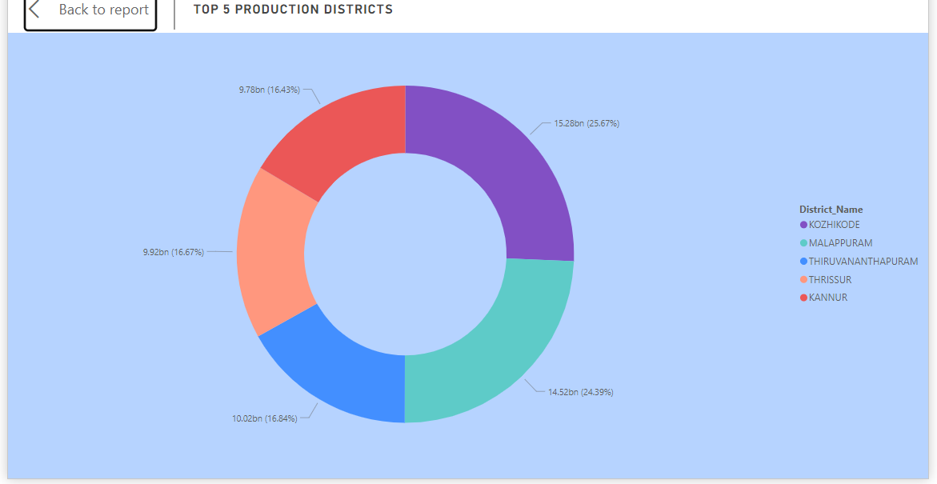

Slide 8
Top 5 Yielding Crops
Coconut: About 28.38m area was used to produce about 129bn of coconut.
Sugarcane: 76.68m area was used in the production of about 5.5bn of sugarcane.
Rice: The area of about 747.13m was used for the production of 1.6bn of the rice.
Wheat: Area of 470.71m was utilized in the production of about 1.3bn of this crop.
Potato: 170.66m area of land was used to produce the sum of about 424.8m of the crop.

Slide 9
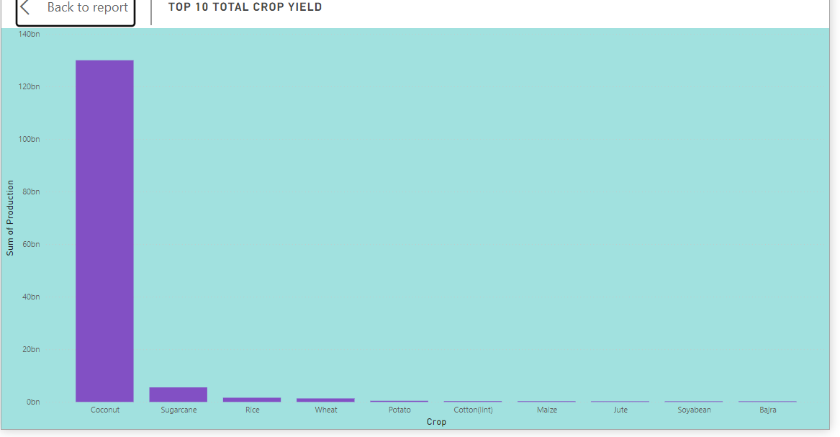

Slide 10
Season with the the highest Crop yield
Kharif and Rabi seasons with the highest crop yield of 4.03bn and 2.05bn respectively are the seasons with the highest crop yield or production.
Season with the Lowest Crop Yield
Autumn with the total crop production of 64.41m of the total production is the season with the lowest crop yield.

Slide 11
The Lowest Yielding Crops
Some lowest Yielding crops are:
Bitter gourd: whose total yield is 353 and was cultivated the whole year in Tamil Nadu, Manipur and Kerala.
Turnip: The crop’s total yield is 363, was cultivated the whole year in Tamil Nadu and Jammu and Kashmir.
Bottle gourd: Total yield is 598 the whole year in 4 states namely Telangana, Tamil Nadu, Manipur and Andhra Pradesh, Etc

Slide 12
Key Insights
Kerala state dominates crop production, with the top 5 districts (kozhikode, malappuram, thiruvananthapuram, thrissur, and kannur) accounting for a significant portion of total crop yield.
Whole year planting results in the highest crop yield, followed by kharif and rabi seasons.
Top yielding crops (coconut, sugarcane, rice, wheat, potato) are planted in larger areas of land, indicating a positive correlation between area and yield.
4. Certain districts (Gulbarga, Bidar, Barabanki, Ambala, Karnal) have extremely low crop yields, indicating potential areas for improvement.

Slide 13
Recommendations
Replicate Kerala's farming methods in other states to improve crop yields.
Encourage whole year planting and optimize crop selection for each season.
Increase land allocation for top yielding crops to maximize production.
Provide support and resources to low-performing districts to enhance crop yields.
Explore opportunities for crop diversification and rotation to optimize land use.

Slide 14
Conclusions
This analysis highlights the importance of understanding crop production patterns and identifying key indicators of success.
By replicating effective farming methods, optimizing planting seasons and crop selection, and supporting low-performing districts, India can enhance crop yields and improve food security.

